Slide 1
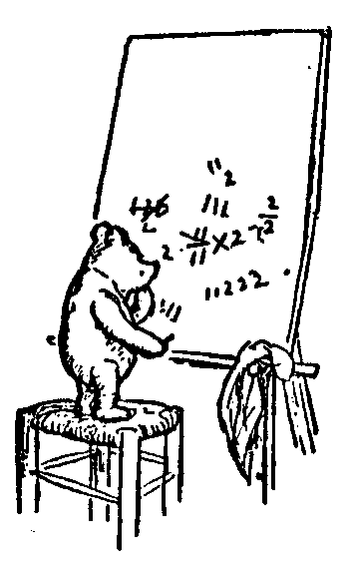

Predicate Logic for Computer Science
Welcome
Administrative Issues
Course Overview
Jeff Edmonds www.cse.yorku.ca/~jeff\courses/1090
jeff@cse.yorku.ca CSB 3044, ext. 33295
647-688-7413
Jeff Edmonds
York University
Lecture 0

Slide 2
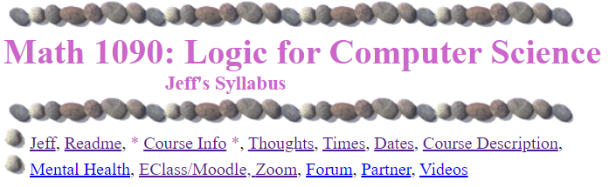
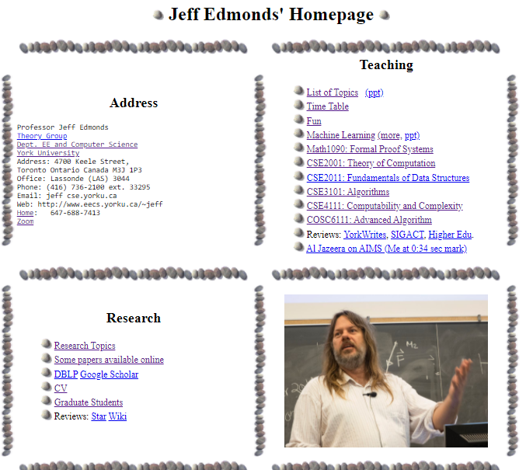
Course Info
https://www.eecs.yorku.ca/~jeff/courses/1090/syllabus/

Slide 3
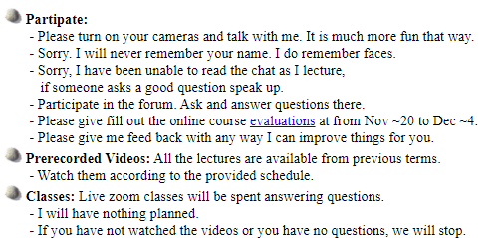
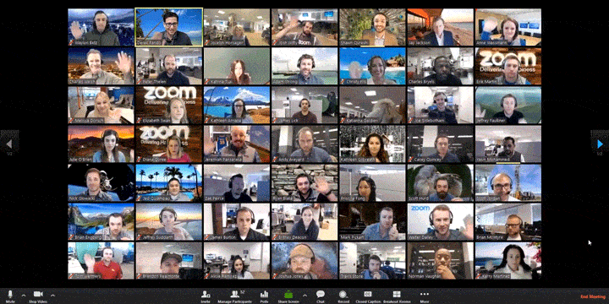
Course Info
https://www.eecs.yorku.ca/~jeff/courses/1090

Slide 4
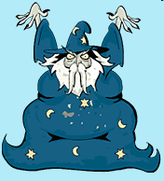
Course Info
https://www.eecs.yorku.ca/~jeff/courses/1090
Some students feel too intimidated to talk to the professor.
Actually, he is just a guy who has been doing this for a while.

Slide 5
Course Info
https://www.eecs.yorku.ca/~jeff/courses/1090

Slide 6
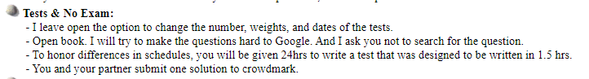





Course Info
https://www.eecs.yorku.ca/~jeff/courses/1090
Let’s go early!

Slide 7
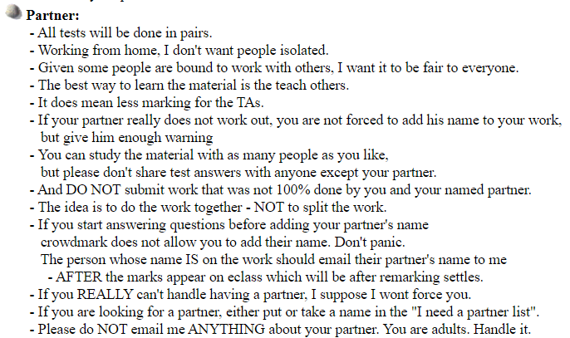


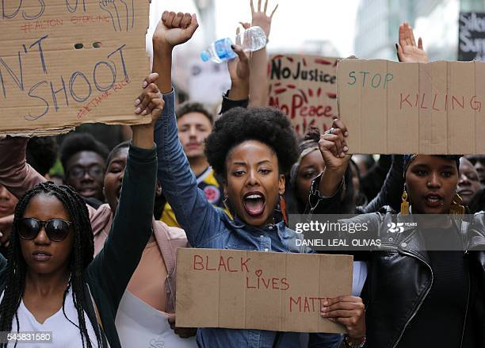




Course Info
https://www.eecs.yorku.ca/~jeff/courses/1090

Slide 8
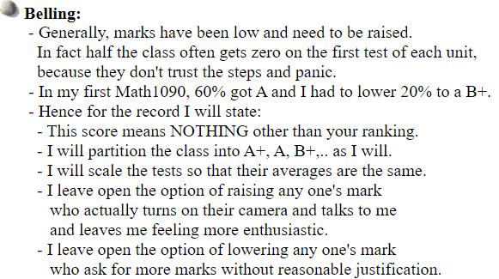
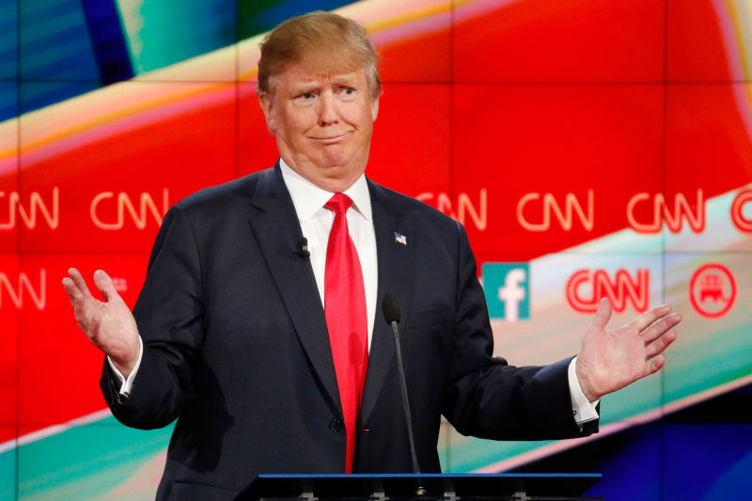
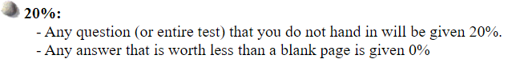
Course Info
https://www.eecs.yorku.ca/~jeff/courses/1090
I have no idea!?!

Slide 9
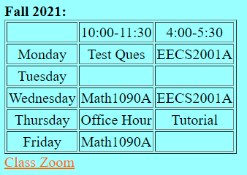
Course Info
https://www.eecs.yorku.ca/~jeff/courses/1090/syllabus/
Is this a good time for an office hour?
Answer questions about tests

Slide 10
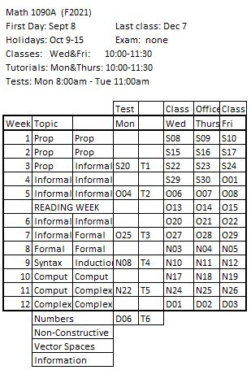
Course Info
https://www.eecs.yorku.ca/~jeff/courses/1090/syllabus/

Slide 11
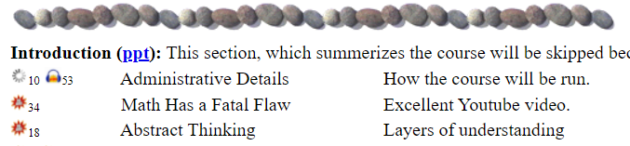
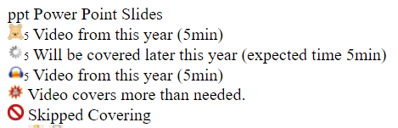
https://www.eecs.yorku.ca/~jeff/courses/1090

Slide 12
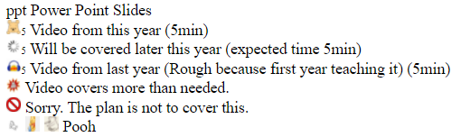
Course Info
https://www.eecs.yorku.ca/~jeff/courses/1090/syllabus/

Slide 13
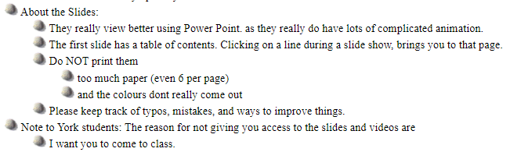
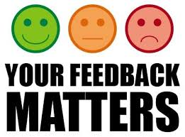

Course Info
https://www.eecs.yorku.ca/~jeff/courses/1090/syllabus/

Slide 14
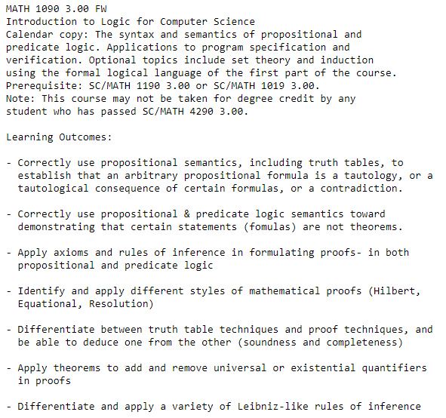

Course Info
https://www.eecs.yorku.ca/~jeff/courses/1090/syllabus/

Slide 15
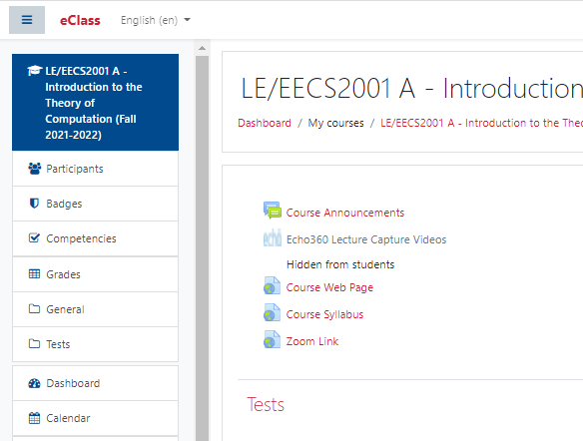
Course Info
https://www.eecs.yorku.ca/~jeff/courses/1090/syllabus/

Slide 16
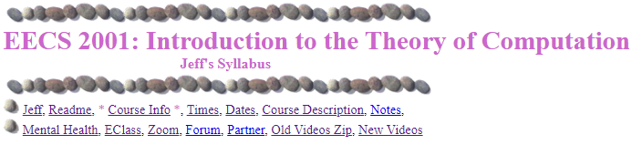
Course Info
https://www.eecs.yorku.ca/~jeff/courses/2001/syllabus/

Slide 17
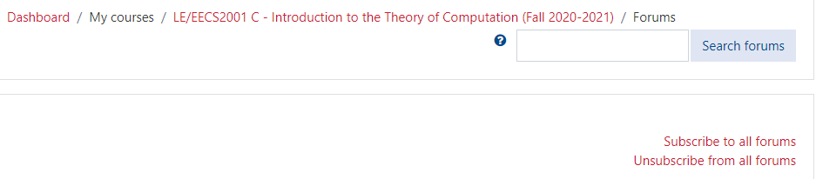
Course Info
https://www.eecs.yorku.ca/~jeff/courses/2001/syllabus/
If someone sets up a Discord thread, I will link it here.
Don’t assume I will or won’t read Discord or Zoom messages.

Slide 18
Course Info
https://www.eecs.yorku.ca/~jeff/courses/2001/syllabus/

Slide 19

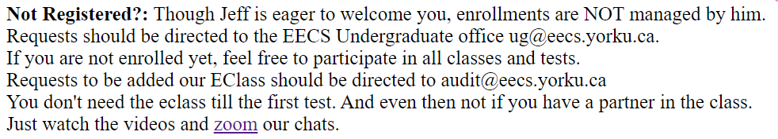
The class should have 100 but has 240.
I am happy to let any one in.
I have told this to the powers to be.
Now it is in their hands.
Please do not ask me about it.
In the meantime, attend lectures!

Slide 20
When you email me something - 1090 in topic
- A photos helps

Slide 21
Study Now!
You spend 50hrs/week on your programming course.
People do work hard on my assignments.
But they don’t really study the material deeply until they fail the midterm.

Slide 22
Read Ahead
You are expected to read the lecture notes before the lecture.
This will facilitate more productive discussion during class.
Also please proof read assignments & tests.
Like in an English class

Slide 23

Explaining
We are going to test you on your ability to explain the material.
Hence, the best way of studying is to explain the material over and over again out loud to yourself, to each other, and to your stuffed bear.

Slide 24
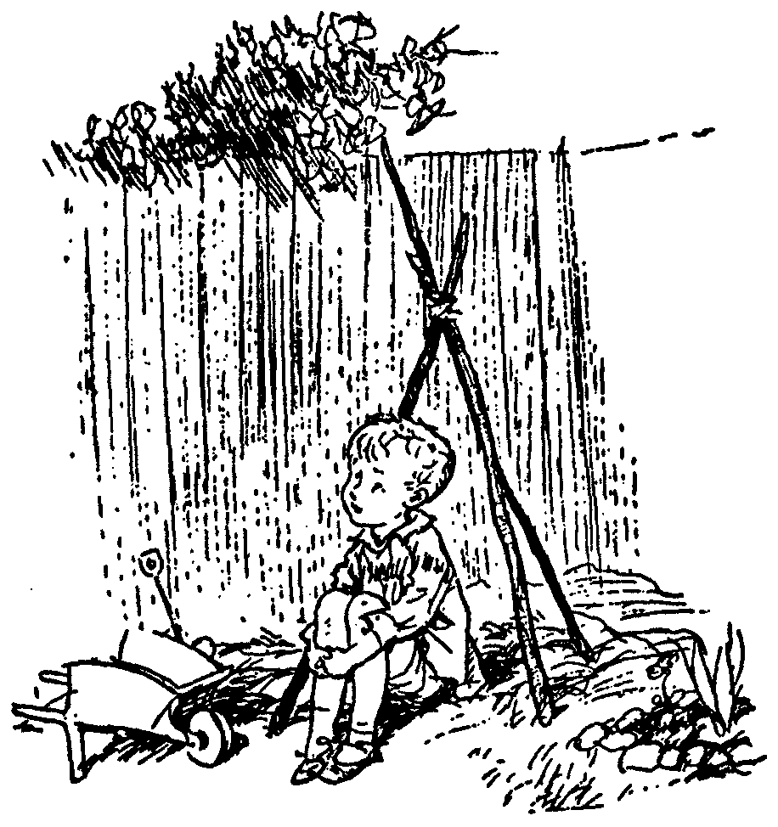
Day Dream
While going along with your day
Mathematics is not all linear thinking.
Allow the essence of the material to seep into your subconscious
Pursue ideas that percolate up and flashes of inspiration that appear.

Slide 25
Math 1090: Logic for Computer Science
I have complained for years.
Being too mechanical.
Not enough understanding.
I believe I have made it better.

Slide 26

I do believe that the material
if you could really get it
can help your math/cs studies
immensely!

Slide 27
Its a tough course, some will understand it better Jeffs way, some will understand it better Georges way. I believe that each teacher should introduce their key differences at the first lecture, for people who may want to switch early on. People may not be aware of the differences between jeff and george. Its important to have different approaches at the same topic.
The way it gets the gears in my head turning. The course material is interesting in and of itself. Math 1019 kind of set me up for failure and made me fear 1090, but honestly I was blessed with the professor I got. He sort of opened my third eye and allowed me to love discrete mathematics! This experience has truly made me believe that a professor has a SIGNIFICANT impact on my attitude towards the class and how I approach it!
I believe this course could make use to people of all areas of science. It opens your mind to ideas not regularly explored by most and although can be confusing, confusion in this context is just a symptom of exploring mentally. I really do think this course but ESPECIALLY jeff, changed the way i look at things in computer science and also regular day life.
The course material was straightforward and if you put effort, you can understand the topics well.
It helped me learn how to think logically from a math perspective and use it in real life.

Slide 28
The course took two approaches (informal and formal) to tackling the same core concept. This helps break down the essence of the more formal component.
Informal proofs were a great concept but I think their execution needed some adjustment. A lot of people struggled with capturing the big idea of what "the game" is meant to do, and how exactly it proves anything. In absence of these big ideas the game lost its intended effect and became much more like a mechanical "write this, then this, then that, QED“
and not our understanding of Jeffrenese.
The professor. Please god, don't give him tenure.
make a textbook for this course or section. Powerpoint slides only not enough
Shorter tests that don't take most students more than 4 hours to finish. In general, the students spent more than 8 hours or even pushing 10-14 hours to finish the test
Professor Edmonds is an incredible professor. I believe that he genuinely cares about his students and works really hard to make the course not only enjoyable for students but also a great learning opportunity. I love the way that he teaches, as a visual learner I feel like I actually understood the material way better than I had before. I definitely believe Professor Edmonds should be the main professor for this course. The way that he does proofs completely changed my view of proofs all together. I genuinely enjoy doing it way more than I previously had.

Slide 29
I believed that the informal proofs helped me understand the material better. Personally, I still had a bit of difficulty understanding the formal proofs, but the professor's teaching style felt a bit more practical and I did not feel as if I needed to blindly memorize the material.
Jeff gets me thinking of hundreds of different ways to solve one simple problem. He started with the basics and showed us from simple problems, how to solve harder problems! The way he set up his tests guided my thought process and always managed to light up the little light bulb in my head. He talks with confidence and clarity that never fails to grab my attention. You can tell he cares about us. Not only because he says so, but because of his actions. He is constantly emailing us, interacting with us, talking about what we're doing well / wrong. He was been incredibly funny since day one and has always made me WANT to attend the lecture. I regret with my whole heart that I took 2001 with George instead of Jeff

Slide 30

Thinking Abstractly
This course requires completely changing the way you think.
Though I keep warning people,
they tend not to get it until they are
Devastated by the midterm
Change your thinking now.

Slide 31
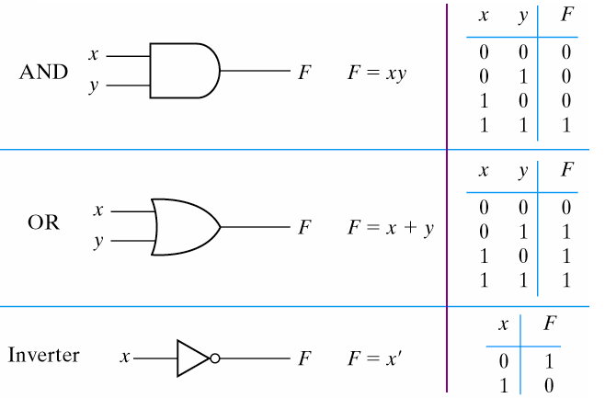
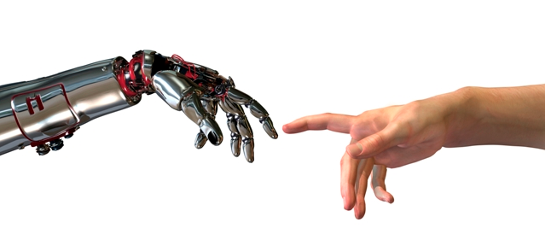
Thinking Abstractly
The psychological profiling of a successful person is mostly the ability to shift levels of abstraction, from low level to high level.
To understand the detailed workings.
To understand the big picture.
Donald Kunth

Slide 32
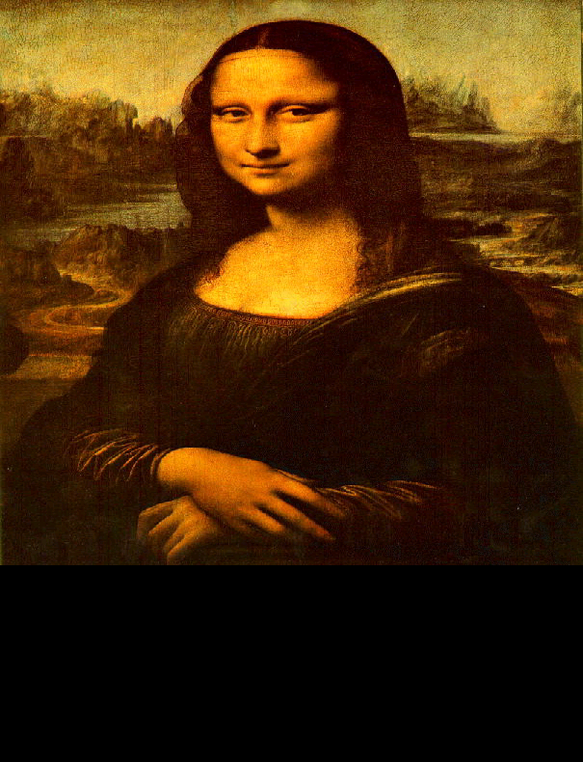
Thinking Abstractly
The psychological profiling of a successful person is mostly the ability to shift levels of abstraction, from low level to high level.
To understand the detailed workings.
To understand the big picture.
To understand complex things in simple ways.
Donald Kunth
=

Slide 33
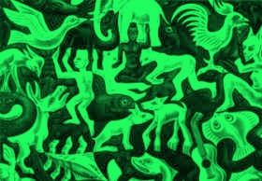
Thinking Abstractly
Paradigm Shift
Is the black the form and the green the background?
Is the green the form and the black the background?
It is helpful to have different ways of looking at it.

Slide 34
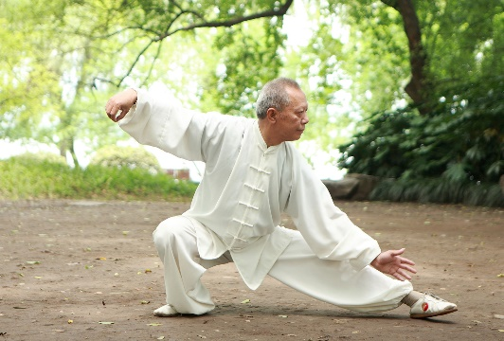
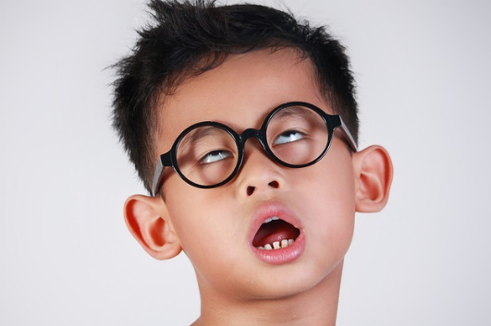

Dude! You will be starting with things that are
Too EASY
A good martial arts student will attentively repeat each fundamental technique many times.
Don’t tune out when a concept is taught more than once.
The better students listen carefully in order to refine and develop their understanding.
Sometimes I use easy thing to teach deep things.

Slide 35


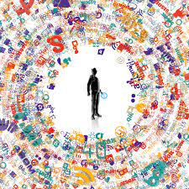
Dude! You will cover things that are
Too Hard
I hope to give you an appreciation for the big picture
It’s really cool.
Don’t panic about details that are too much for you.

Slide 36
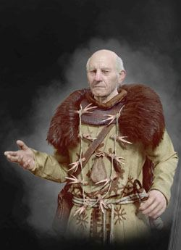
Verify vs Create
“The Rules taught should be the ones our forefathers devised.
All else is dangerous”.
Adding meaning (semantics)
or intuition is bad.

Slide 37
Verify vs Create
I will teach you to factor.
Input: An integer x
Output: Its prime factors ⟨p₁,p₂,…,p_{r}⟩
Verify: p₁×p₂×…×p_{r} = x
Input: x = 12 Output: Factors ⟨2,2,3⟩
Verify: 2×2×3 = 12
Input: x = 7152988453
Output: Factors ⟨182983,39091⟩
Verify: 182983×39091 = 7152988453
Easy!
No problem. I know how to multiply.
I can verify that 182983×39091 = 7152988453.

Slide 38
Verify vs Create
Now the test.
Input: x = 23434551
What are the factors?
Aaaah!
You never taught me how to factor.
That is much much harder!.

Slide 39

Verify vs Create
If you give me a bunch of proofs
and teach me how to verify that they work.
This does not necessarily teach me how to create new proofs.
Let’s try.
Aaaah!
You never taught me how to factor.
That is much much harder!.

Slide 40
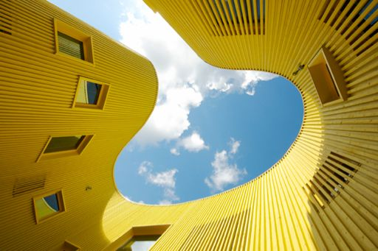
Non-Standard
I found our forefathers' formal proof system overly complicated
and lacking (at least my) intuition

Slide 41

We will now cover the entire course.
Fast.

Slide 42

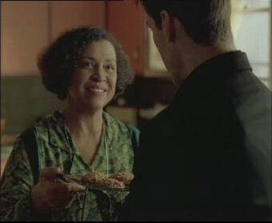
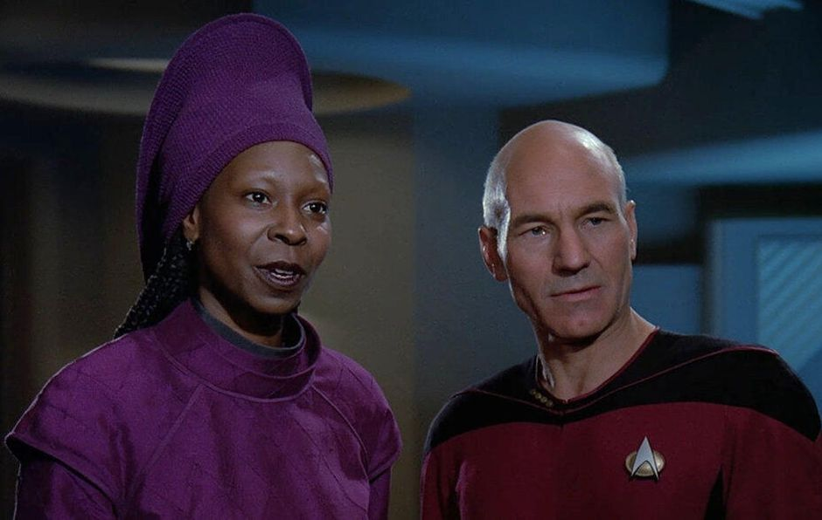
Players
My role is generally is to give rules and proofs.
I try and give a deeper understanding of logic.
Here are two of my best sister.

Slide 43
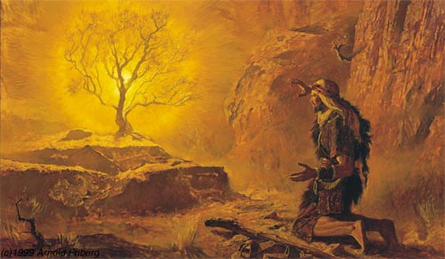
Players
My role is generally is to give rules and proofs.
I try and give a deeper understanding of logic.
We play the logic game together.
I get frustrated!

Slide 44
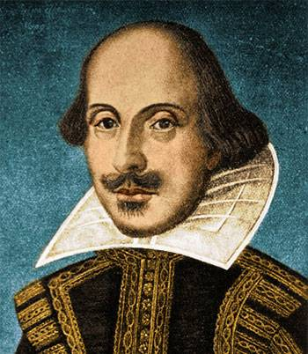
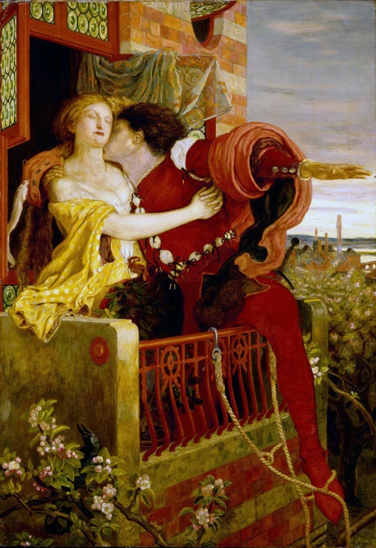
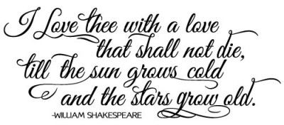
Hugely Expressive
The rules of syntax dictate how words can be strung together into
poetry.
Verses and rhyme …
Shakespeare(1616)
I want this form to be powerful enough to
express everything I have to say about love.

Slide 45
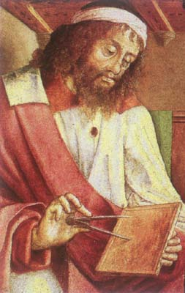
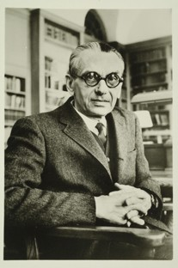
Hugely Expressive
The rules of syntax dictate how words can be strung together into
logical sentence.
Variables x and y can represent integers.
You can use +, ×, <, =, ≥, ∀, ∃, ∧, ∨, ⌐, →.
Euclid (300 BC)
I want this form to be powerful enough to
express everything I have to say about
math.
Actually, it is hugely expressive.
This is excellent way to understand and prove most mathematical statements.
“x is prime”
≡ ∀a ∀b (a×b=x → a=1 or b=1)
Gödel
1931

Slide 46

Hugely Expressive
The rules of syntax dictate how words can be strung together into
logical sentence.
Variables x and y can represent integers.
You can use +, ×, <, =, ≥, ∀, ∃, ∧, ∨, ⌐, →.
Euclid (300 BC)
I want this form to be powerful enough to
express everything I have to say about
comp sci.
Here is J´ an integer encoding of Java program J.
“Java program J on input I outputs y”.
≡ ∃c ∀t (J´×…. +I´ = …. y´)
There is an integer encoding a computation c
such that for every time step t
the TM simulating J takes a legal step

Slide 47
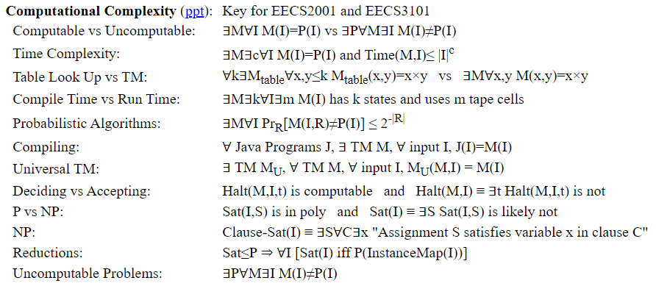
Hugely Expressive
Certainly it is key to theoretical computer science.
“Java program J on input I outputs y”.
≡ ∃c ∀t (J´×…. +I´ = …. y´)
There is an integer encoding a computation c
such that for every time step t
the TM simulating J takes a legal step

Slide 48
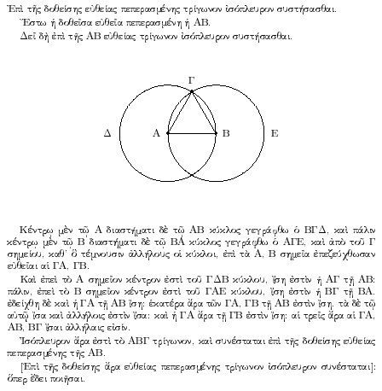
History of Proofs
Euclid said,
“ Let there be proofs”
Euclid (300 BC)
And it was good.

Slide 49
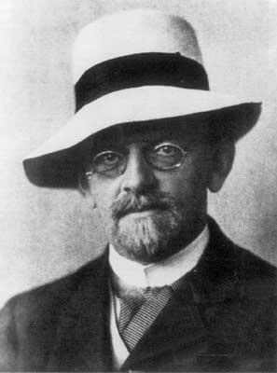
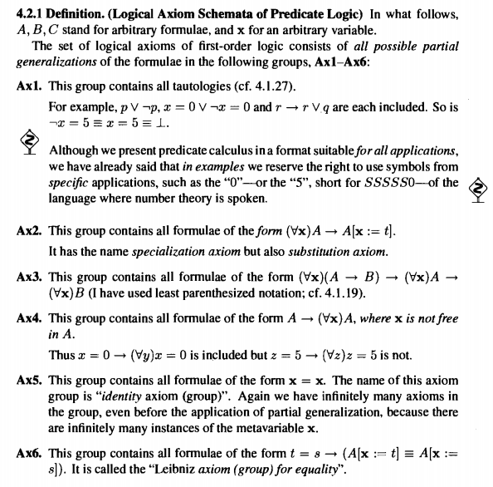
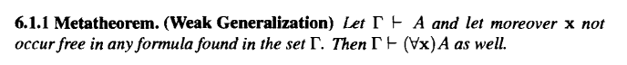
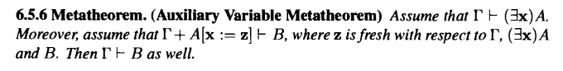
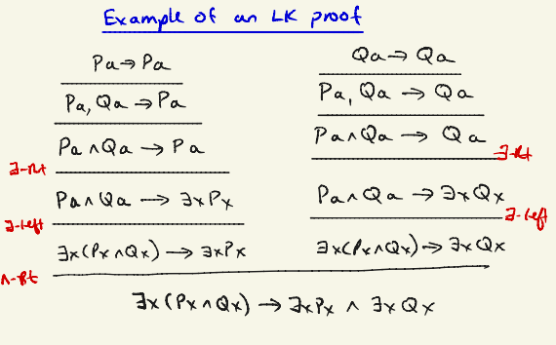
History of Proofs
In 1920, Hilbert wanted mathematics to be formulated on a solid and complete logical foundation.
There are many formal proof systems that we use.
Hilbert
Jeff made up his own proof system.

Slide 50
History of Proofs
In 1920, Hilbert wanted mathematics to be formulated on a solid and complete logical foundation.
Hilbert
Its is fun to have a really trimmed down proof system from which you can prove everything!
Its is fun to have a really intuitive and robust proof system from which proving things is easy!

Slide 51
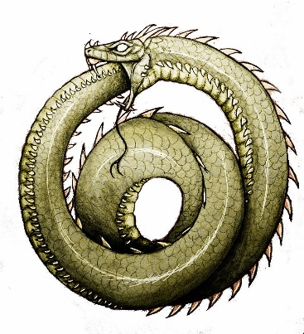

History of Proofs
If formula Φ is true in every model M´ for which the axioms Γ are true,
then it has a proof in our proof system with axioms Γ.
No formal proof system Γ is capable of proving
all valid and no invalid formulas Φ
about the integers.
Gödel’s Completeness Theorem
1931
Incompleteness
Intuition:
A logic formula can talk about itself.
Φ = “Φ has no proof in your proof system”.
If it is true, then it has no proof.
If it is not true, then it has a proof.
Both are problems.

Slide 52


Propositional Logic
In English, a Proposition is a statement or assertion that expresses a judgment or opinion.
Eg: “All people are created equal”
“We are all equal, just some of us are more equal than others.”
In Propositional Logic, each formula/variable evaluates to true/false.
These are combined with Not, And, Or, Implies, and Iff ¬, ∧, ∨, →, iff
Our goal will be to prove what follows from what.

Slide 53
And
Or
Proof Techniques/Lemmas
And ∧:
Or ∨:
Implies →:
Negation ¬:
Using:
Proving:
From:
Conclude:
From:
Conclude:
Separating And
Eval/Build ∧
α∧β
α & β
α, α´, & ¬β
α∧α´ & ¬(β∧γ)
Selecting Or
Eval/Build ∨
α∨β & ¬α
β
α, ¬β & ¬β´
α∨γ & ¬(β∧β´)
Cases
Excluded Middle
α∨β, α→γ, & β→γ
γ
α∨¬α & ¬(α∧¬α)
Modus Ponens
Deduction
α & α→β
β
Assume α, prove β
α→β
Cases
Eval/Build →
α∨β, α→γ, & β→γ
γ
α, α´, & ¬β
γ→α, β→γ, ¬(α→β)
Equivalence
Contrapositive
α→β & β→α
α iff β
¬(α∧¬β) iff ¬β→¬α
α→β
Transitivity
Transitivity
α→β & β→γ
α→γ
α→β & β→γ
α→γ
Double Negation
De Morgan's Law
¬¬α
α
¬(α∧β)
¬α∨¬β

Slide 54

Predicate Logic
Predicate Logic talks about the properties of objects.
Father(x,y) ≡ “x is y’s father”
Daughter(y,x) iff Father(x,y)∧Female(y)

Slide 55

Predicate Logic
∀x, ∃y, y>x
For All integer x,
there Exists a y
that is bigger.
x?
0?
1?
2?
3?
…
The integers go on forever.
No matter how many people are in the hottub,
you can always fit one more.
y is bigger.
1 is bigger.
2 is bigger.
3 is bigger.
4 is bigger.

Slide 56
Informal Proof as a game
Predicate Logic
∀x, ∃y, y>x
Every logic sentence corresponds to a game.
Prover can always win
if and only if
statement is true.
The proof:
Let x be an arbitrary integer.
Let y = x+1
Note y = x+1 >x
Read the statement left to right.
I, the advisory, am invested in proving that the sentence is false.
Or at least giving the prover as hard of a time as I can.
I produce a worst-case object when it is a ∀.
I, the prover, am invested in proving
that the sentence is true.
I produce a good object when it is a ∃.
The prover wins
if y>x.

Slide 57
Informal Proof as a game
Predicate Logic
As an oracle, I can help too.
When proving α→β, I will help you assume α.
Understanding this game is 50% of the course!

Slide 58
Predicate Logic
Informal Proof as a game
“I don’t play games".

Slide 59
Our Formal Proof Systems
Rules:
Removing ∀: From line ∀x α(x), include line α(term) (eg α(x)).
Adding ∀: From line α(x), include line ∀x α(x).
Removing ∃: From line ∃y α(x,y), include line α(x,y∃(x)).
Adding ∃: From line α(term), include line ∃y α(y).
Negating ∀&∃: ¬[∀x α(x)] iff ∃x ¬α(x).
Deduction:
Goal is to prove α→β
______ α assumption
______ …
______ β
α→β conclusion
(Not for x∃
or x´).
(Except ∀x α(x,term(x))).
(x´)
(x´)
Notes:
59

Slide 60
Abstraction
The point of formal proofs is
to prove theorems
with as few assumptions as possible
about the nature of the objects we are talking about
so that we can find a wide range of strange new objects
for which the same theorems are true.
Notes:
60

Slide 61

Induction

Slide 62

Computing

Slide 63




Complexity
Euclid (300 BC)
Hilbert (1900)
Gödel 1931
Turing (1936)
Edmonds 1965
Cook 1971

Slide 64

Vector Spaces

Slide 65
End

